Slide 1

Personal Protective Equipment – Selection, Use and Maintenance
Chemical and Lab Safety Program
Environmental Health and Safety
306 Benson School

Slide 2
About This Training
Please plan to review this training during normal business hours. If at any time during the training you have questions, contact Jocelyn Locke at jlocke@mailbox.sc.edu (803) 777-7650 or Adam Roberge at aroberge@mailbox.sc.edu.

Slide 3

Course overview
This course is designed to provide UofSC faculty, staff, and students with the necessary knowledge to minimize the risk of exposure and injury when handling hazardous chemicals while performing their job duties.
This course is required for all research faculty, staff, and students prior to working in the laboratory. A refresher must be completed every two years thereafter.
Once you completed this course, you and your supervisor will sign a training document (see next slide).
Notes:
All employees who have occupational exposure to bloodborne pathogens must receive initial and annual training.
The following training is provided to fulfill this OSHA training requirement and to promote a safe work environment for all USC faculty, staff and students with potential exposure to bloodborne pathogens as a result of performing their job duties.

Slide 4
PPE Training DOCUMENTATION
I, (Principal Investigator printed name and signature ) __________________________________________________ certify that the following lab personnel have completed the course on Personal Protective Equipment by viewing the Power Point presentation and asking questions about any item that was not clear. In addition, the following lab personnel has received hands-on instructions and training on how to select, use and maintain PPE from a competent individual in my laboratory.
Lab Personnel | Name | Date | Signature | Name and signature PPE Trainer
1
2
3
4
5
6
7
8
9
10
11
12
13
14
15

Slide 5
COURSE MOdules
1. OSHA Personal Protective Equipment (PPE) Standard
2. PPE as a Control: Their Function and Limitations
5. Proper Use of PPE
4. Do I need a respirator?
6. Maintaining PPE
7. UofSC Lab PPE Policy
3. PPE Products: Selecting the Appropriate Ones

Slide 6
MODULE 1
The OSHA Personal Protective Equipment Standard

Slide 7
What is Personal Protective Equipment?
Personal protective equipment, commonly known as PPE is equipment worn to minimize exposure to hazards that cause serious workplace injuries and illnesses.
Injuries and illnesses may result from contact with chemical, radiological, physical, electrical, mechanical, or other workplace hazards.
PPE may include items such as gloves, safety glasses and shoes, earplugs or muffs, hard hats, respirators, coveralls, vests, and full-body suits.
This training focuses on the use of PPE for protection against exposure to hazardous chemicals and selected physical hazards in the laboratory.

Slide 8

What standard/s apply to PPE?
General Industry (29 CFR 1910)
Subpart I - Personal Protective Equipment
Click on the links below to learn more about PPE regulations.
1910.132, General requirements.
1910.133, Eye and face protection.
1910.134, Respiratory protection.
*1910.135, Head protection.
1910.136, Foot protection.
**1910.137, Electrical Protective Equipment.
1910.138, Hand Protection.
*1910.140, Personal fall protection systems.
*Usually not needed in a lab environment except in buildings and rooms under construction or renovation
**Required for primary insulation when working with energized circuit parts

Slide 9
What do the PPE standard/s require?
Employers shall
Identify hazards present that requires the use of PPE
Obtain appropriate PPEs
Train employees on
when PPE is necessary
what kind is necessary
how to properly put it on, adjust, wear, and take it off
the limitations of the equipment
proper care, maintenance, useful life, and disposal of the equipment
Module 2
Return to Course Modules

Slide 10
MODULE 2
PPE as a Control: Their Function and Limitations

Slide 11
When must PPE be used? Why is it used a “last resort”?
HAZARD
RISK
Elimination, substitution, downscaling
Engineering
Administrative
Personal Protective Equipment
Emergency Response
Remove, replace, reduce
Most effective
Isolate people or hazard
Change work practice
Fundamentally used as a last resort, when other controls cannot eliminate the hazards and risks of materials used in the workplace.
Protect person
Although least in the hierarchy, it can effectively create a barrier against the entry of hazardous chemicals into a person’s body.
Least effective
Minimize consequence
Because it is the “last line of defense”, failure of the PPE to protect will result in exposure and injury.
CONSEQUENCE

Slide 12



Wearing PPE PROTECTS YOU!
Chemical exposure routes |  | Protect/create a barrier for
Skin |  | Skin
Mucous membranes of the eyes, nose, mouth |  | Eyes, nose, mouth
Injection |  | Skin
Ingestion |  | Hand, mouth
Inhalation |  | Nose/respiratory system

Slide 13
Why is PPE used only as a last resort?
PPE only protects the wearer.
It is ineffective if not working or fitted properly.
Theoretical levels of protection are seldom reached in practice.
The use of PPE always restricts the wearer to some degree.
The psychological effect of PPE may be such that the individual wearing the PPE feels more protected than he/she actually is.
Therefore, all controls on the top of the hierarchy (downscaling, engineering, administrative) must be implemented before relying on PPE for protection.
Module 3
Return to Course Modules

Slide 14
MODULE 3
Personal Protective Equipment: How to Choose the Appropriate Products

Slide 15
What should I do before buying PPE?
Supervisor conducts hazard and risk assessment
- identify the correct type of PPEs to protect against hazards present
-identify PPE with a level of protection appropriate for the level of risk
Select PPE according to wearing and fitting - one size may not fit all
Select PPE that is user friendly- one that fits the individual correctly
Consider individual medical conditions that may restrict the wearing of PPEs (i.e. allergies, vision, etc.)
Ensure that the selected PPE is designed, manufactured, and tested in compliance with nationally recognized safety and performance standards (i.e., ANSI Z87, UL Listed, CE Marked).

Slide 16
Required PPE must be determined per individual, for example:
Lab Personnel | Hazard Handled | Exposure Risk Level | PPE Fit | Physical and medical considerations | Product compliance with standards | Other considerations (cost) | PPE Selected
Jane D. | Concentrated nitric, sulfuric, formic acids | High (prepares 5N dilutions using 2 L of concentrated acids weekly for acid baths, rise glasswares in acid baths, potential for splash) | Small frame | Wears prescription glasses | ANSI Z87 | VWR offers institutional discount | Safety goggles that fits small frame and fits over prescription glasses Face shield, adjustable for small frame Nitrile gloves, 6 mil, elbow length, small
John M. | 0.5 M hydrochloric acid | Low (adjust pH of buffers with ~ 10 ml of 0.5 M HCl) | Large frame | None | ANSI Z87 | VWR offers institutional discount | Safety glasses that fit a large frame Nitrile gloves, 2 mil, wrist length, large

Slide 17
Minimum Lab PPEs
Lab entry requirement: proper lab attire
clothing that minimizes exposed skin such as sleeved shirts, long pants or equivalent, and
full-coverage shoes
While handling chemicals with minimal hazard:
safety glasses for eye protection,
chemical-resistant gloves for hand protection, and
lab coat for additional skin protection.

Slide 18
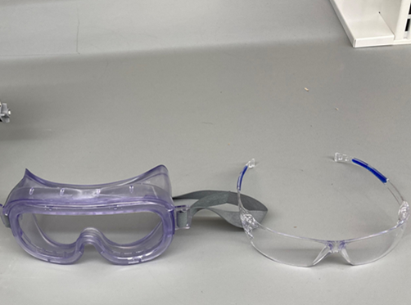

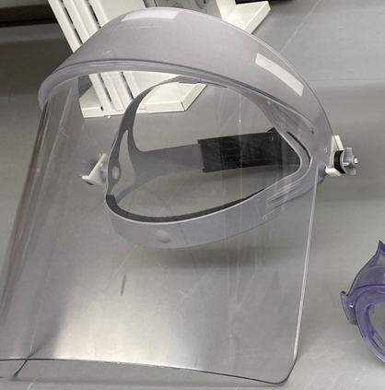
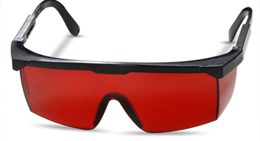
Select eye and face PPE according to the hazard type and levels of exposure risk (example).
Hazard type (RISK LEVEL) | Lab activities example | Suitable eye PPE
Corrosive (LOW) | Adjusting pH of buffers using ~ 20 ml of 0.5 M HCl | Safety glasses
Corrosive (HIGH) | Rinsing glassware in 10 M HNO₃ | Safety goggle and face shield
Cryogen (MODERATE) | Transferring liquid nitrogen from a large supplier dewar into a 10 L dewar | Safety goggle and face shield
Laser Class IIIB (High) | Laser is used for laser diffraction experiment; includes laser beam alignment | Laser goggle

Slide 19
Are my glasses safety glasses?
Regular Glasses
Safety Glasses
Designed to correct vision
Glass or plastic, thicker lenses
Lens may shatter upon impact.
Polycarbonate - lightweight
Impact resistant
Passed ANSI design and testing standard
Stamped “ANSI Z87+” or equivalent on the lens or frame
“+” rating indicates passing the high impact test

Slide 20
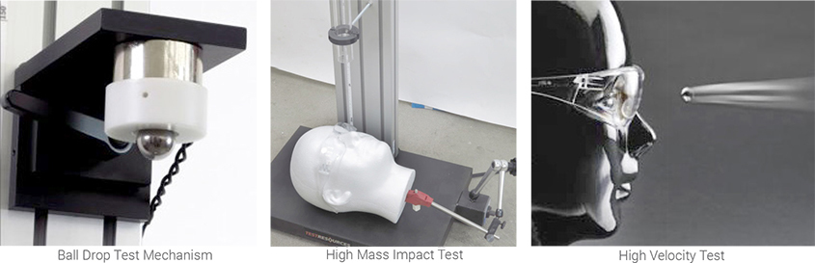
Impact testing for ANSI Z87 Rating

Slide 21

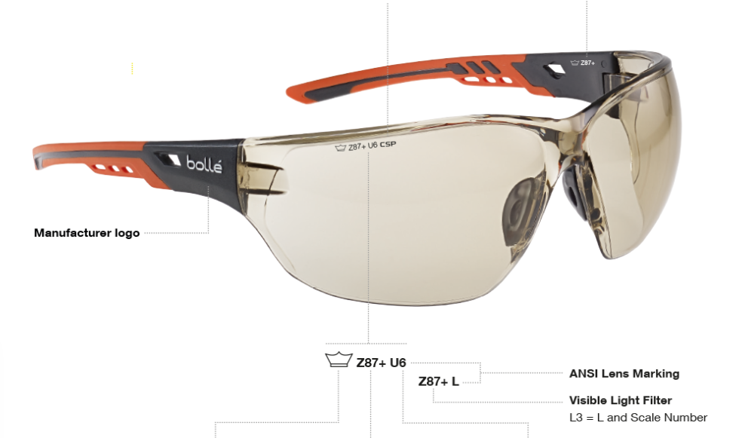
Are my glasses safety glasses?
Regular/Prescription Glasses
Safety Glasses

Slide 22
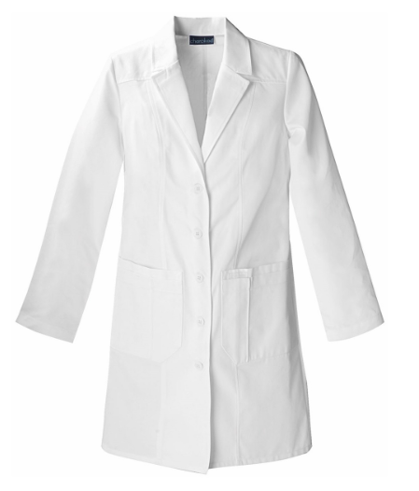
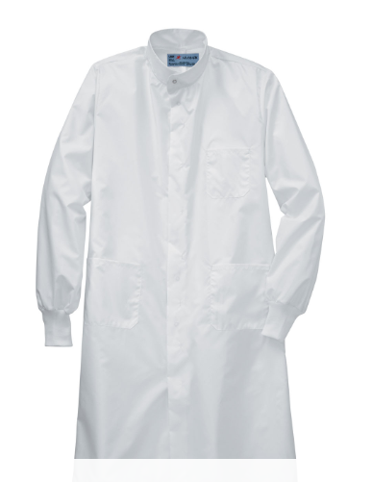
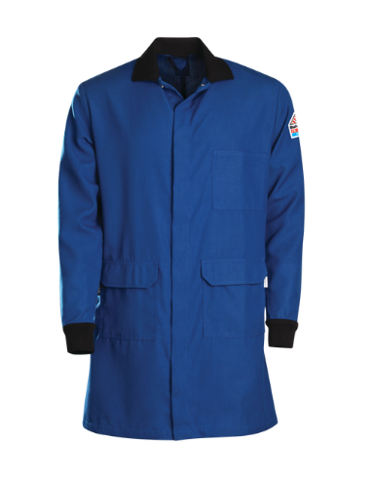
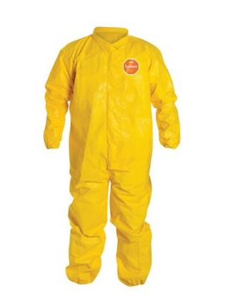
Select skin PPE according to the hazard type and level of exposure risk.
Hazard type (RISK LEVEL) | Lab activities example | Suitable skin PPE
Chemical (LOW) | Handling dilute concentrations of hazardous chemicals | Traditional lab coat
Biological (MODERATE) | Handling bloodborne pathogens and other potentially infection materials | Barrier lab coat
Flammable or pyrophoric chemical (HIGH) | Handling flammable or pyrophoric chemicals | Flame resistant
Hazardous chemicals (HIGH) | Clean-up of large volume of hazardous chemical spills | Chemical-resistant suits

Slide 23
Examples of suitable lab coat products with varying hazard types and risk levels
Click on the link below:
National Institutes of Health Guidance for the Selection of Laboratory Coats

Slide 24
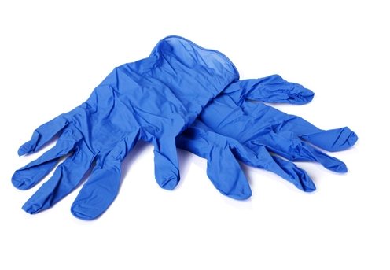

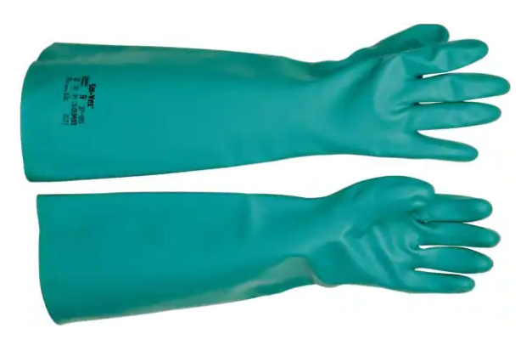
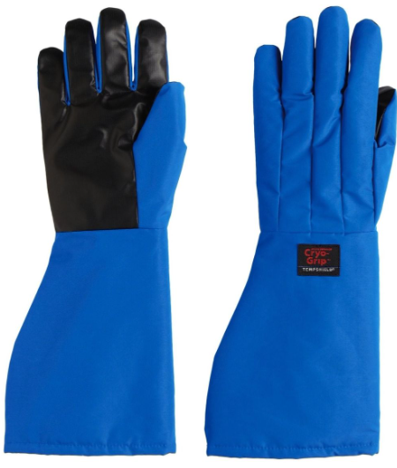
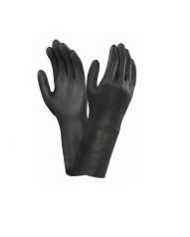
Select hand PPE according to hazard type and level of exposure risk
Risk type (RISK LEVEL) | Lab activities example | Suitable hand PPE example
Corrosive (LOW) | Adjusting pH of buffers using ~ 20 ml of 0.5 M HCl | Nitrile 3 mil, wrist-length
Corrosive (HIGH) | Rinsing glassware in 10 M HNO3 | Nitrile, 8 mil, elbow-length Acid-resist apron
Cryogen (MODERATE) | Transferring liquid nitrogen from large supplier dewar into a 10 L dewar | Cryogen glove
Hydrofluoric Acid (Moderate) | Adding 5-ml aliquot of concentrated HF to rock samples | 5 mil chloroprene, mid-arm length over 3 mil nitrile
b

Slide 25
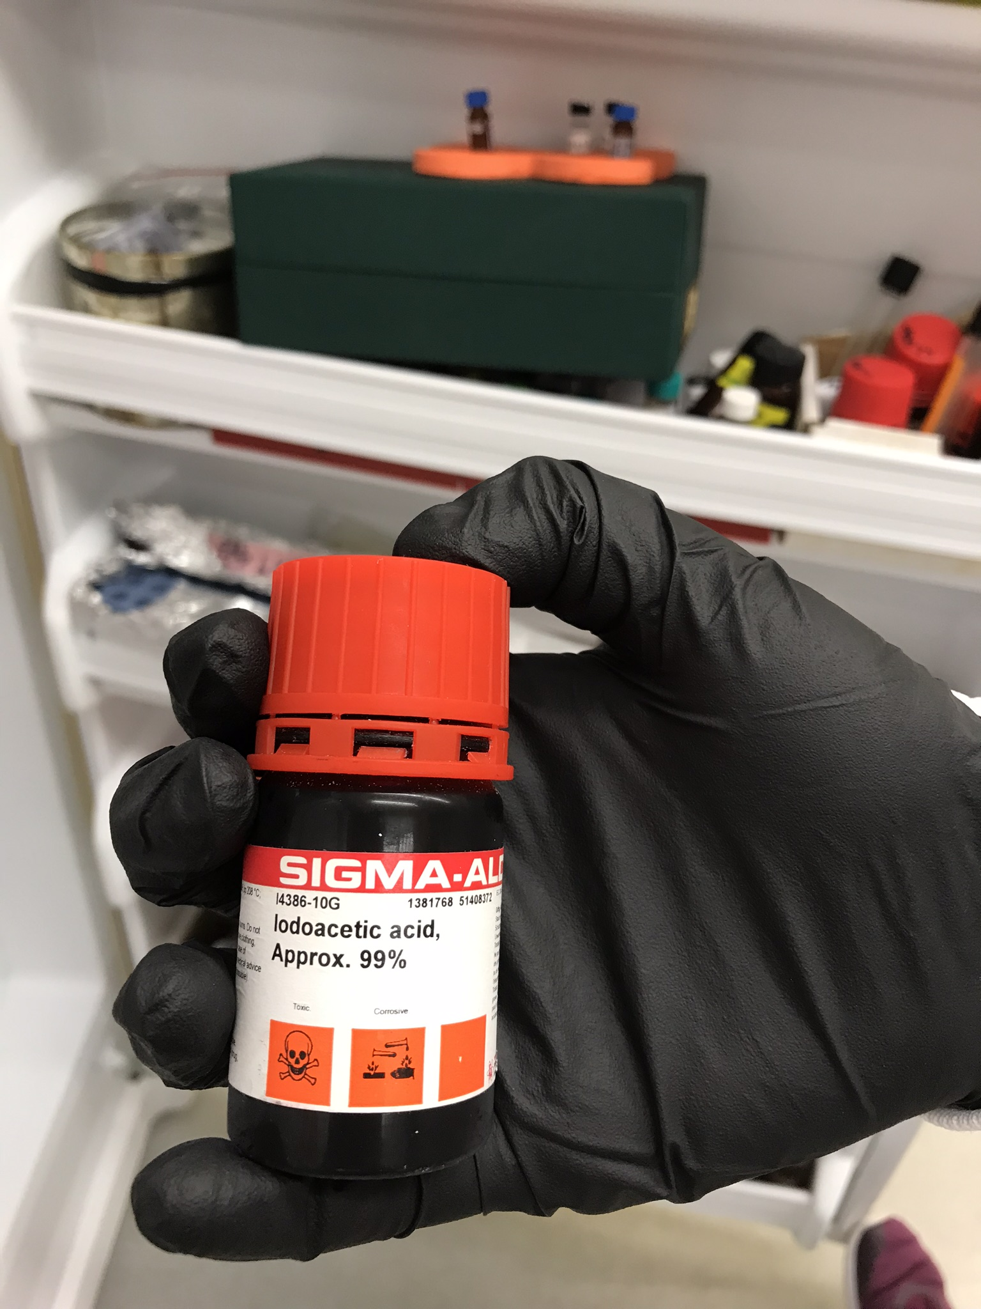
Am I wearing the appropriate gloves?
To find out, visit your glove manufacturer or distributor’s website and consult their glove compatibility guide!

Slide 26
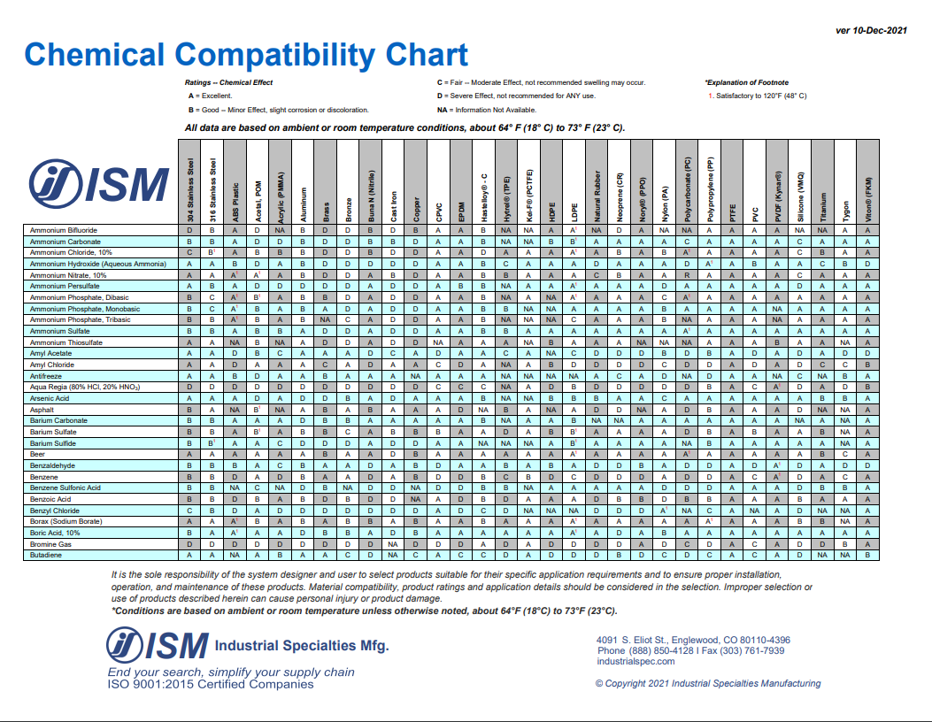
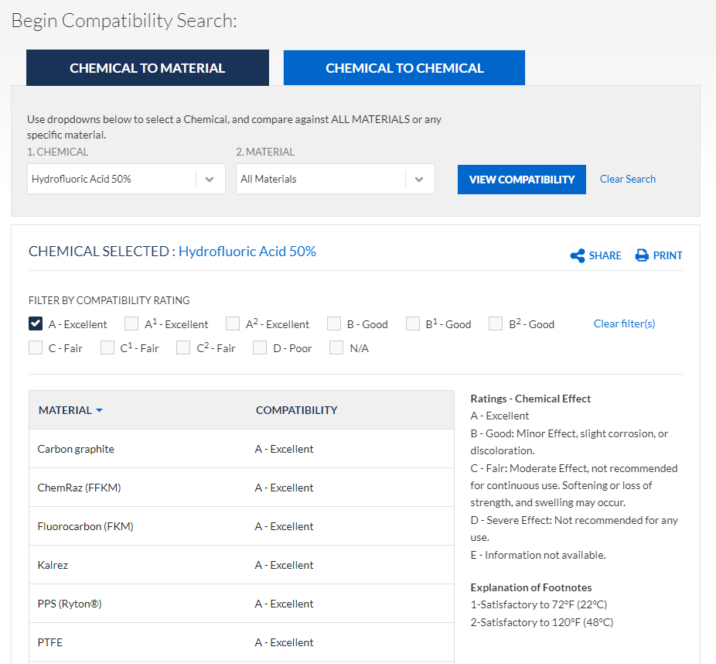
Consult the manufacturer’s Glove Compatibility Chart to determine the type of gloves resistant to specific chemicals.
Example: https://www.coleparmer.com/Chemical-Resistance

Slide 27
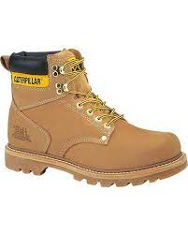

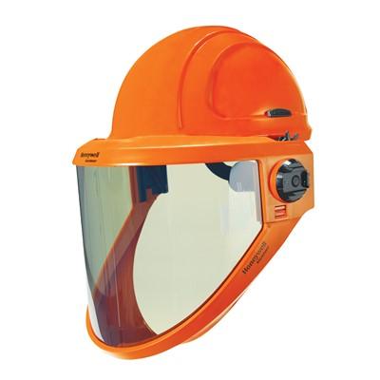
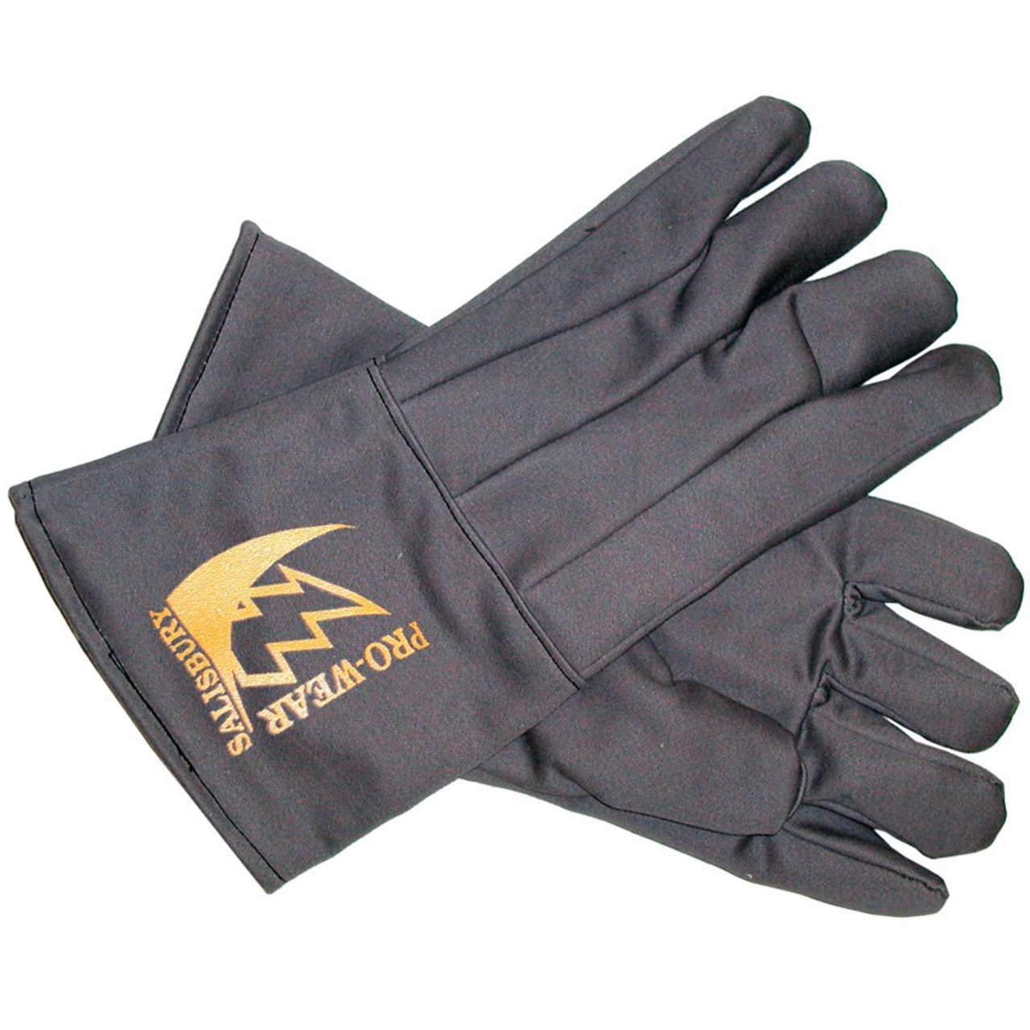
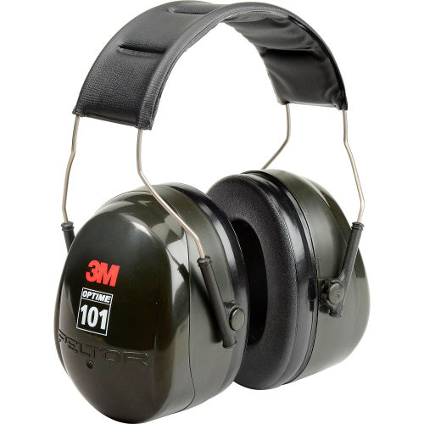
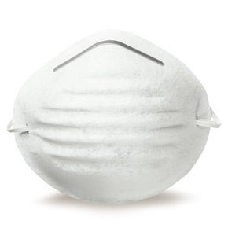
Non-chemical hazards that require additional PPE
Hazard type | Required PPE
Noise above 90 decibel | Earmuff or ear plugs
Nuisance dust | Dust masks
Slippery floor, other foot hazards | Non-slip shoes, safety shoes
Renovation/construction zone | Helmet
Arc flash (electrical) | Arc flash helmet and visor, insulated gloves

Slide 28

Who pays for YOUR PPE?
I’m buying your PPE, all you have to do is WEAR THEM!!!
Your employer.
(If you are a student taking classes in a teaching lab, you may be required to provide your own PPE)

Slide 29
Where to buy PPE from?
Hardware stores generally sell PPEs
However, specialized PPE suppliers will have a broader range of PPE suitable for use in the laboratory and can provide you with good advice on choosing the correct PPE for your needs
Reputable suppliers will offer PPE selections that are designed, manufactured, and tested in compliance with nationally recognized safety and performance standards
Module 4
Return to Course Modules

Slide 30
MODULE 4
Do I Need a Respirator?

Slide 31
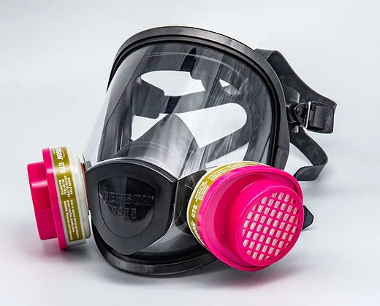
Do I need a respirator?
99% of the time: NO!
Engineering controls must be in place and designed to prevent and eliminate hazardous fumes and particulates escaping into the open lab BEFORE considering the use of a respirator.

Slide 32
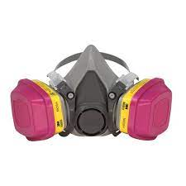

If you think you need a respirator-
Contact EH&S at (803)777-5269 or 777-7650
We will identify and measure the inhalation hazards
We will conduct a hazard and risk assessment to determine if another control can be implemented to reduce the risk or if a respirator is indeed needed for you to safely perform your experiment/procedure/task.
??

Slide 33
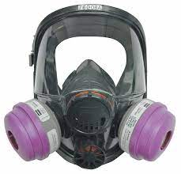


If we (EH&S) determine you need a respirator-
You are required to participate in the UofSC Respiratory Protection program:
Medical Assessment of Employee Health – medical clearance from your physician
Respirator Selection – to ensure that the respirator is appropriate for the hazard present
Fit Testing – to ensure that the respirator fits and will be effective
Employee Training – how to put on the respirator and the required inspection and maintenance
Recordkeeping – inspection and maintenance log
Periodic Program Review – to ensure that the record-keeping is done and that the respirator continues to effectively reduce the exposure risk.
Yes, but…
Module 5
Return to Course Modules

Slide 34
MODULE 5
Training for Proper Use of Personal Protective Equipment

Slide 35
Why do I need training to use PPE?
Know the risks against which you are being protected by the PPE.
Know the level of protection afforded and the limitations of your assigned PPE.
Learn the proper wearing, care, or maintenance of PPE to enable you to make effective use of any PPE provided for your protection.
Know the persons involved in the selection, maintenance, repair, and testing of your PPE as applicable.
The level of training provided will vary with the level of risk involved and the complexity and performance of the PPE. For instance, the use of a respirator will require comprehensive training with regular refresher courses, whereas the training for donning and doffing protective gloves for hazardous chemicals may require a one-time demonstration only.

Slide 36
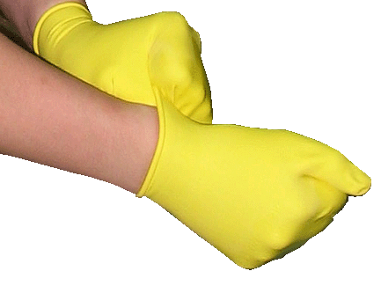
Proper use of PPE: what does this mean?
Properly selected PPE used when handling hazards
Donned (put on) so that PPE fits properly and creates an effective barrier against the entry of hazards
Doffed (take off) properly to prevent cross contamination
Each PPE item inspected prior to use (lab coats for signs of chemical degradation, fraying at the cuffs, stains; gloves for holes, tears, degradation; safety glasses/goggles for scratches and pitting that may impair vision, splash apron for tears, holes and thinning)

Slide 37
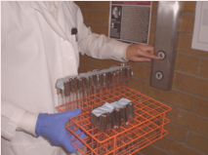
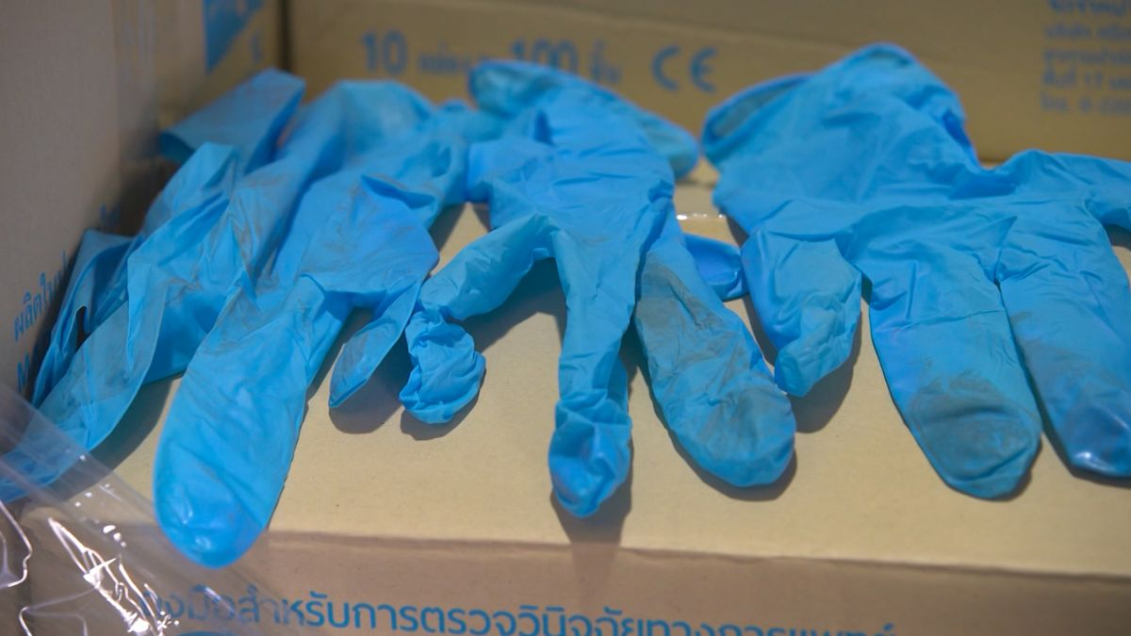
Cont…Proper use of PPE: what does this mean?
PPE removed before leaving the lab
When transporting hazardous materials, one hand gloved, ungloved hand used to operate doorknobs, light switches, elevator buttons, etc.
Disposable gloves that have been used are never, (you read that correctly), never re-used!

Slide 38
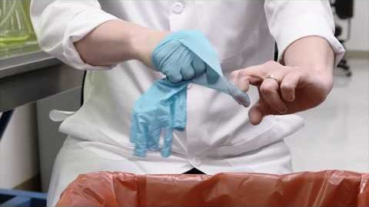

Proper Glove Donning and Doffing
Click on the links below to watch two short videos on proper glove removal techniques.
The goal is to avoid touching the contaminated side of the gloves during the removal process.
Video: Glove removal technique #1
Video: Glove removal technique #2
Module 6
Return to Course Modules

Slide 39
MODULE 6
Personal Protective Equipment Maintenance

Slide 40
PPEs MUST be tested, inspected, and Replaced or Repaired as Needed
PPEs must be thoroughly and regularly examined by a competent staff according to the manufacturer’s instructions.
Simple maintenance may be carried out by the user, provided that the user has been adequately trained (e.g. lens cleaning on goggles or replacing face shield straps).
The examination, maintenance, and repair of PPE used in high-risk situations (i.e. full face respirator) should be carried out by properly trained staff who have the skills and tools to carry out repairs, if needed.

Slide 41

How often should PPE be replaced?
Consult the manufacturer’s specification to determine the end of life, maximum service time, or date of expiration for all PPEs purchased.
Disposable PPEs should be used once, then disposed.
Yes, disposable gloves should never be reused. (Used gloves are contaminated and highly likely partly, if not fully deteriorated from chemical exposure, so therefore must NOT be reused. There, you finally heard the reason why never to reuse disposable gloves).

Slide 42
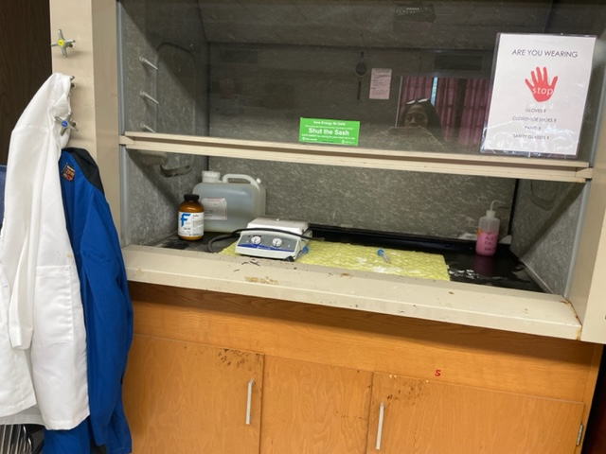
PPEs must be properly stored
Store PPEs according to the manufacturer’s instructions.
Leaving PPE lying around increases the risk of parts being contaminated and deteriorating by exposure to chemicals, dirt, oil, UV rays, sunlight, etc.
Some labs hang their lab coats on the utility knobs on the side of the fume hood. Do NOT follow this example.
Some labs store their HF gloves and apron in the same cabinet where HF is stored. Tell them to never do this!
Some labs keep their used disposable gloves to the side for future reuse. Well, one of the previous slides says to NEVER REUSE DISPOSABLE GLOVES!

Slide 43
Just a friendly reminder-
NEVER reuse disposable gloves!!!
Never, never
Never, never…
Module 7
Return to Course Modules

Slide 44
MODULE 7
UofSC Lab Personal Protective Equipment Policy

Slide 45
Responsibilities
Person | Responsibility
ALL personnel entering a laboratory room | Wear all required PPE for entry (proper lab attire and any additional PPE required by the particular lab)
Principal Investigator/Supervisor | Ensure properly selected PPEs are provided to all laboratory personnel and visitors
Individual Lab Personnel handling hazardous materials | Wear required, assigned PPEs, inform supervisor of any medical or other concerns that restrict the wearing of PPEs, report any defects or damage to PPEs, participate in any PPE training or instruction offered
Students in teaching lab | May be required to provide their own PPEs and wear them while in the lab
Visitors | Wear PPEs provided by the host laboratory

Slide 46
Minimum Lab Entry Requirement (includes proper Lab Attire)
Clothing that provides maximum reasonable skin coverage (i.e., long pants or equivalent, sleeved shirts)
Shoes that cover the entire feet
No dangling accessories
Long hair, if any, tied in a ponytail or equivalent

Slide 47

Risk-based PPE Prescription
PPE worn when handling hazardous chemicals should be based on the level of exposure risk, which in turn depends on the type of chemical, volume, concentration, and additional process hazards such as splash potential, heating, pressurization, and aerosolization, etc.

Slide 48
A risk-based approach to prescribed PPEs (example)
Risk Level | Lab Hazard | Prescribed PPE
LOW | Very dilute concentration of hazardous chemicals | Barrier lab coat, safety glasses, nitrile gloves
MEDIUM | Concentrated corrosive chemicals, with the potential for splash | Barrier lab coat, safety goggles, face shield over safety goggles, gloves specifically resistant to substance/s handled
HIGH | Flammable or pyrophoric chemicals | Flame-resistant (FR) lab coat, safety goggles, gloves resistant to specific substance/s handled

Slide 49
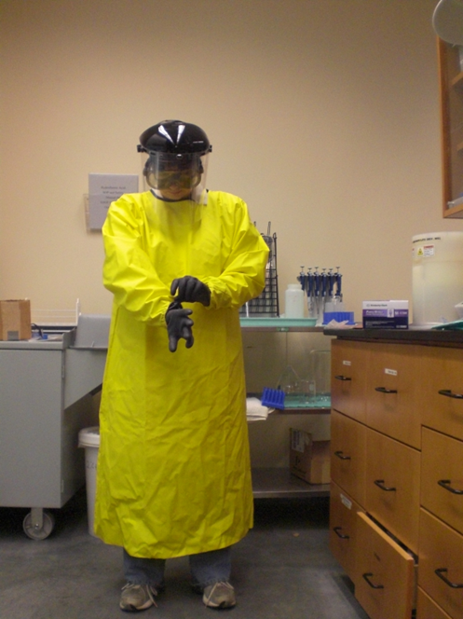
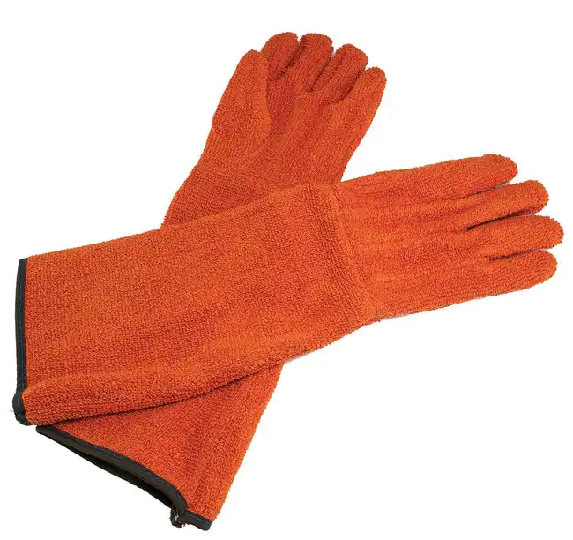

Appropriate PPE for specific hazards and tasks (examples)
Hazard | Task | Prescribed PPE
Cryogen | Transferring liquid nitrogen or retrieving samples from liquid-nitrogen-filled dewar | Barrier lab coat, face shield over safety goggles, cryogen gloves
Strong corrosives | Working with >200 ml concentrated HF | Barrier lab coat, acid-resistant sleeved coat that ties in the back (over lab coat), tightly fitting safety goggles, face shield over safety goggles, chloroprene gloves (at least 0.6 mm thick), acid resistant booties over shoes
High temperature, steam | Retrieving items from an autoclave | Barrier lab coat, face shield over safety goggles, autoclave gloves
Laser | Laser beam alignment | Laser safety goggles, traditional lab coat

Slide 50
Lab-specific PPE Guidelines
Lab Principal Investigator reserves the right to enforce a stricter PPE requirement than what is stated in the UofSC PPE policy.
For instance, lab-specific guidelines may require everyone to wear safety glasses before entry into a particular laboratory.

Slide 51
Consequence of non-wearing of PPEs
All lab personnel are required to wear appropriate PPEs when entering a lab and when handling hazards
When PPEs are not worn, the PI needs to find out if there are genuine difficulties encountered when wearing particular PPEs and resolve these difficulties.
Persistent non-wearing of required PPEs is a cause for suspension of an individual’s access to the laboratory

Slide 52


Test your acquired knowledge.
What’s wrong with these pictures?

Slide 53
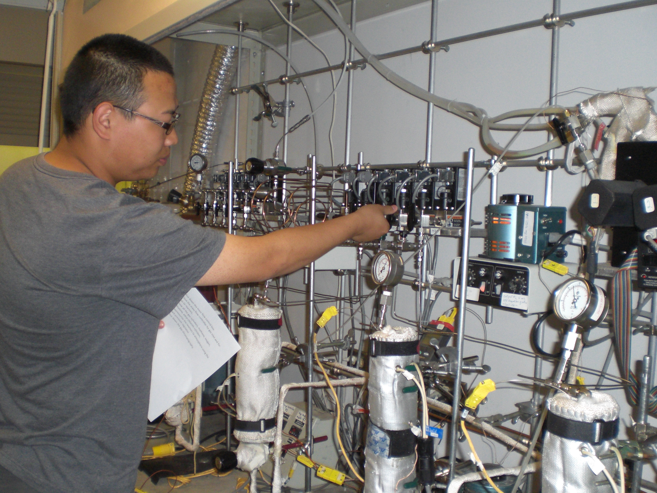
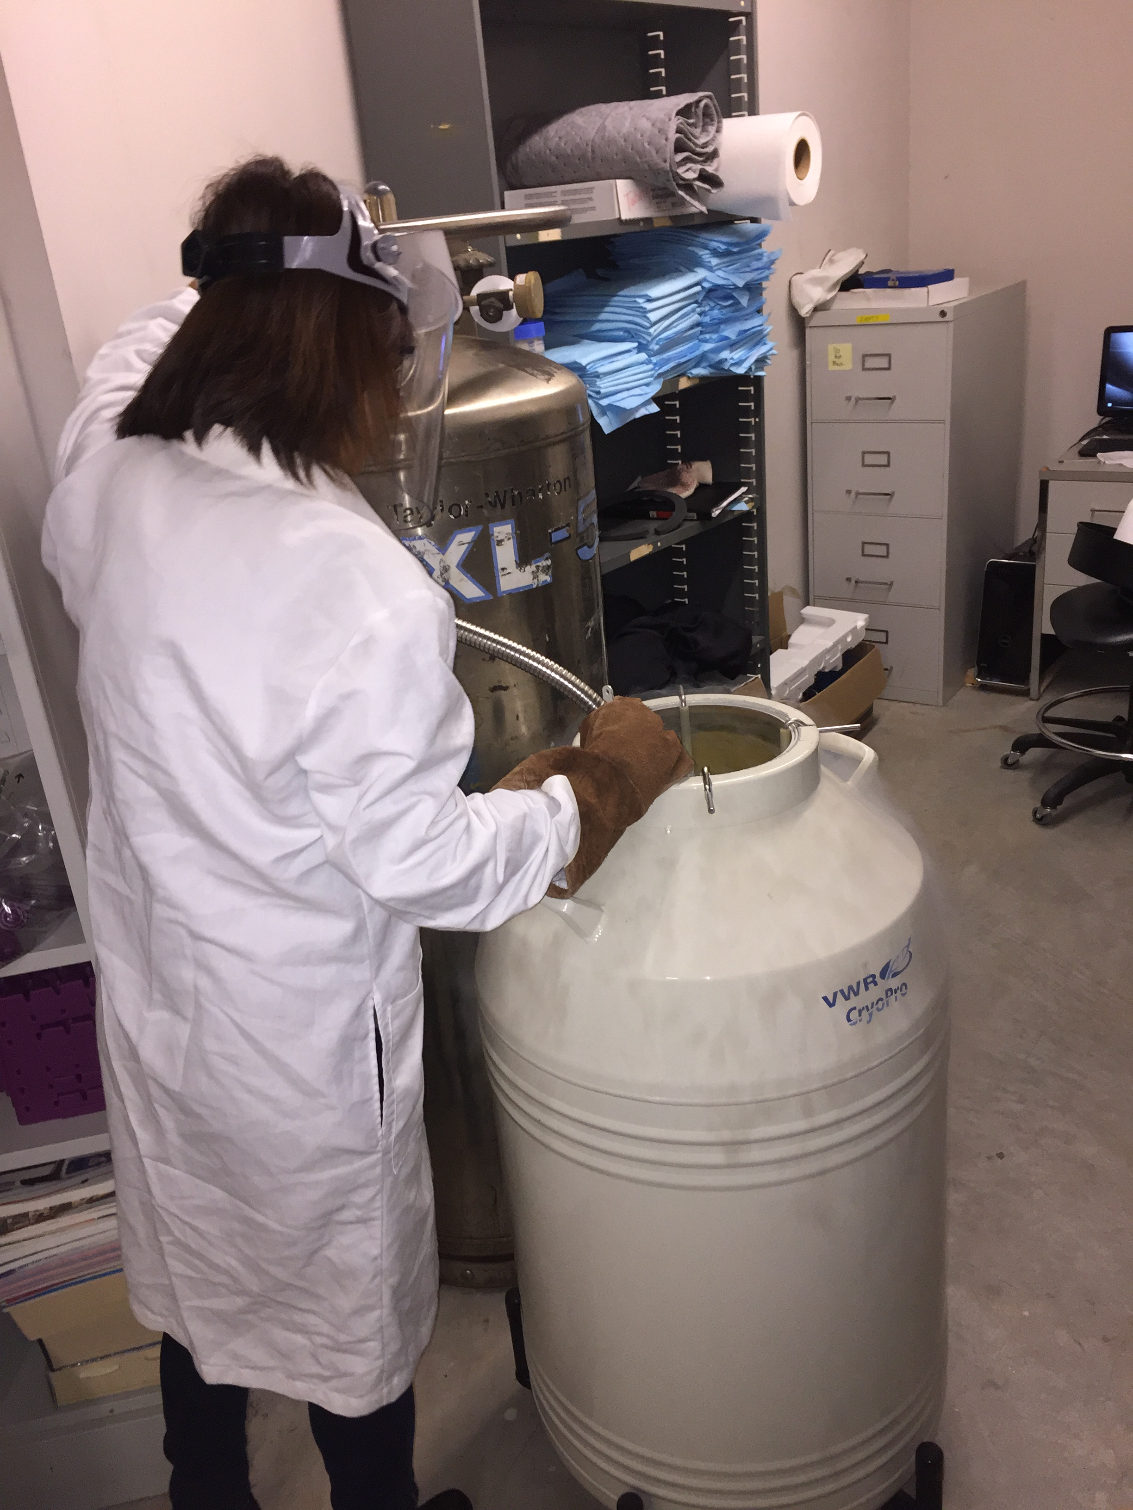
What’s wrong with these pictures?

Slide 54
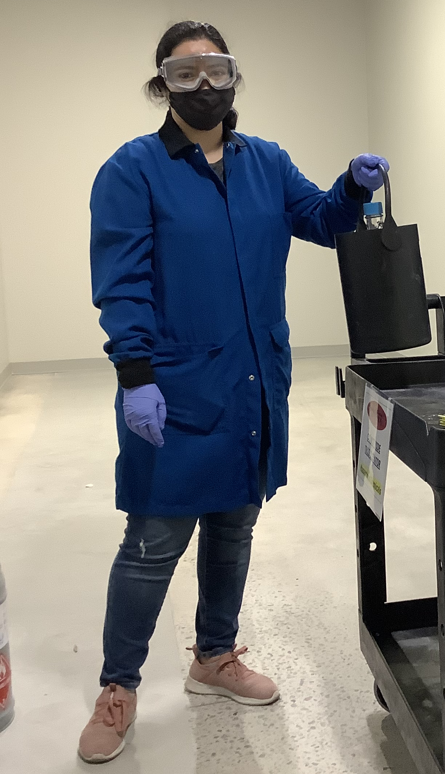
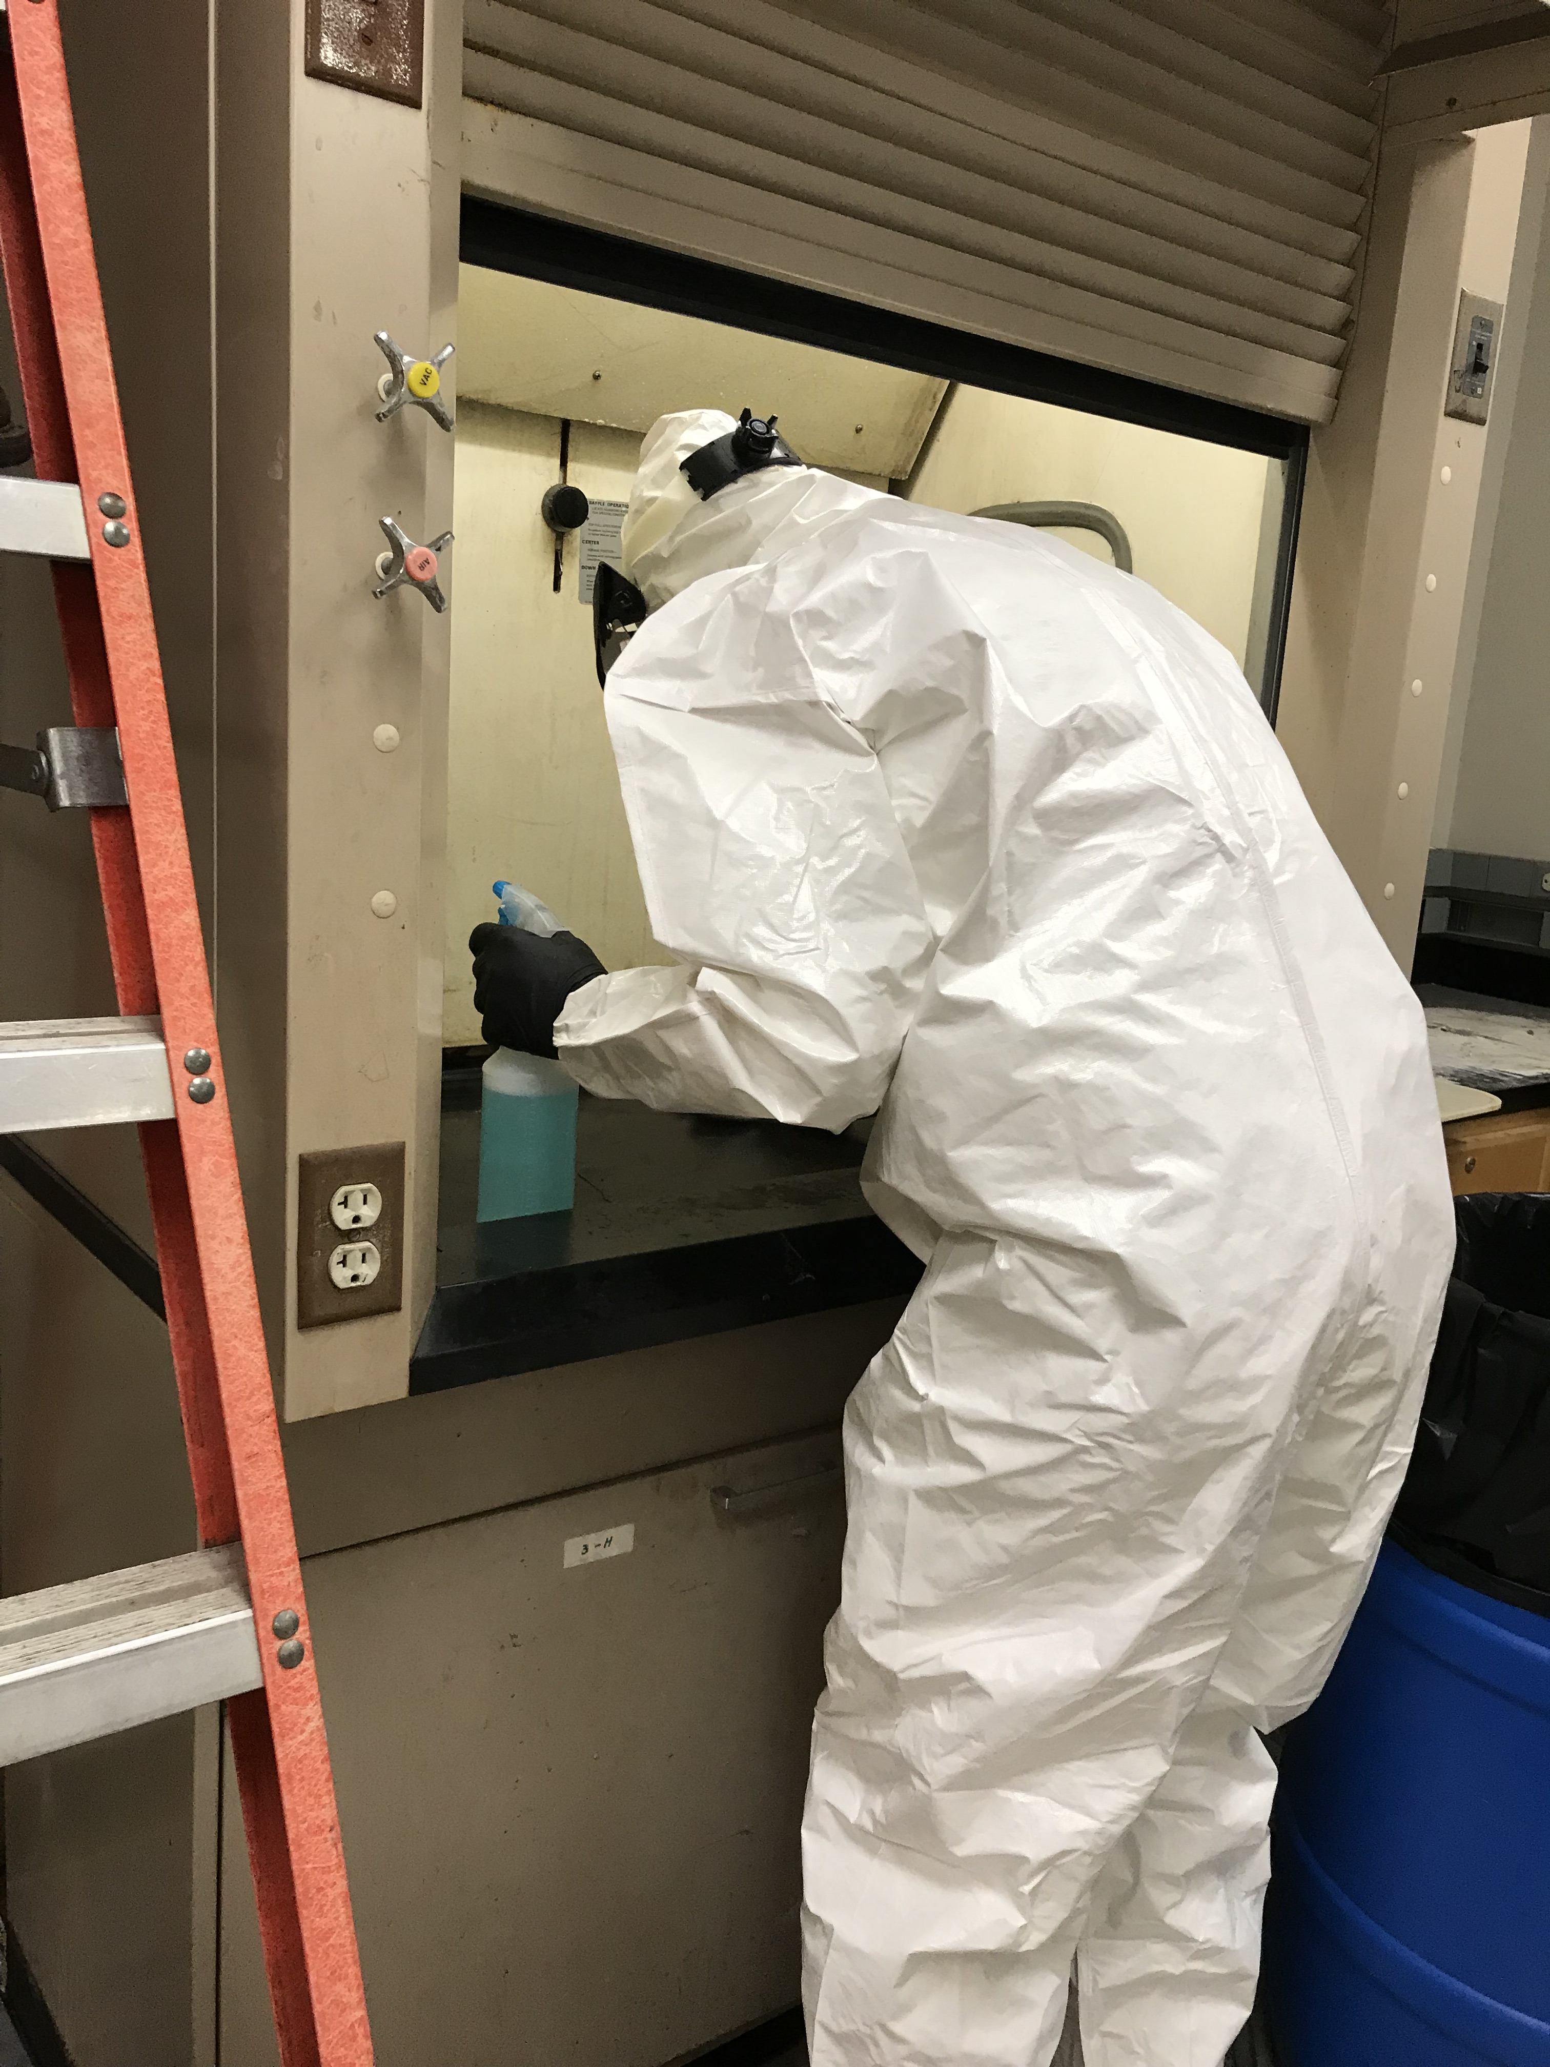
What’s wrong with these pictures?

Slide 55
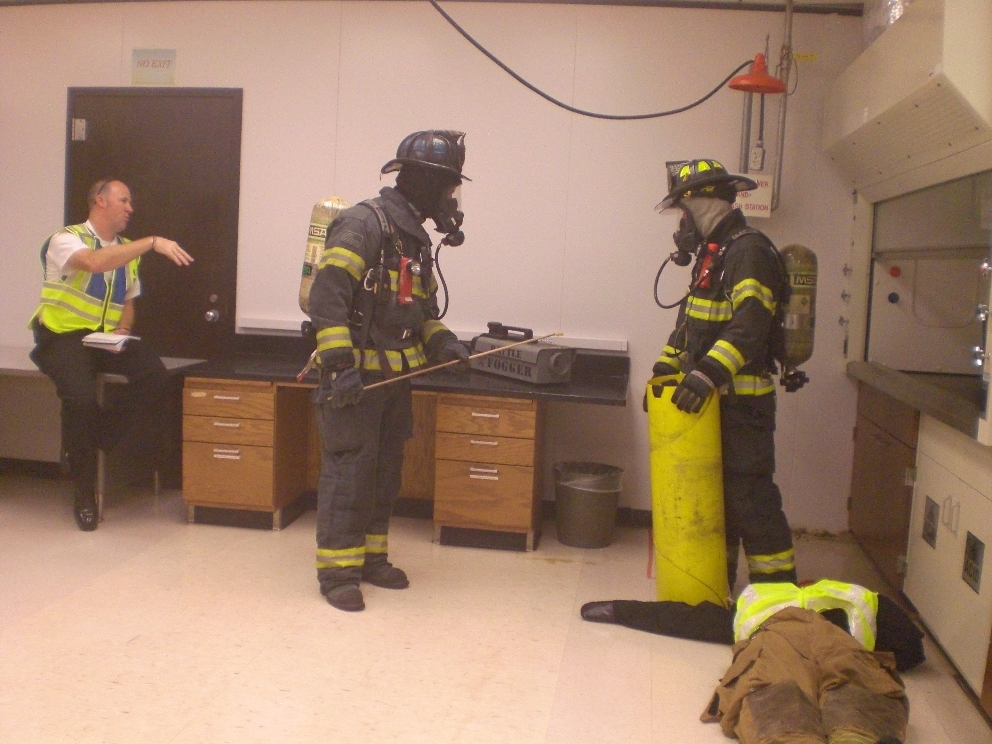
What’s gravely wrong with this picture?

Slide 56
QUESTIONS?
Jocelyn Locke (803) 777-7650
jlocke@mailbox.sc.edu
Adam Roberge aroberge@mailbox.sc.edu
Thank you!

