Slide 1
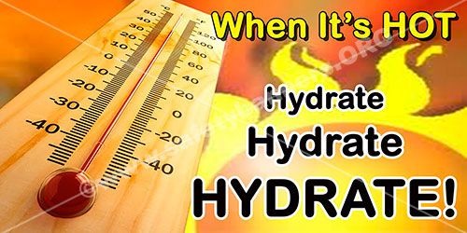
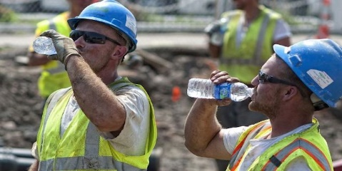
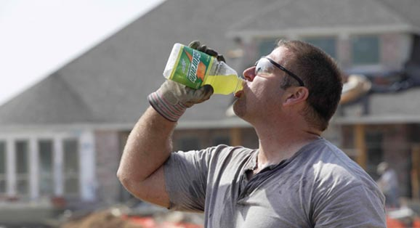
HEAT STRESS Training

Slide 2
Factors Increasing Risk for
Heat-Related Illnesses
Climate
Exercise and activity
Age
Pre-existing illness or conditions
Drugs and/or medications
Clothing

Slide 3
Heat-Related Illnesses
Dehydration
Heat cramps
Heat exhaustion
Heat stroke

Slide 4
Dehydration: Signs and Symptoms
Early Signs………
Fatigue or weakness
Headache, irritability or dizziness
Nausea
Dizziness
Excessive thirst
Dry lips and mouth

Slide 5
Dehydration: Signs and Symptoms
Later Signs………
Disorientation
Loss of appetite or severe thirst
Dry mucous membranes or sunken eyes
Lowered blood pressure or rapid pulse
Decrease in perspiration
Dark, amber urine/lack of urine output
Unconsciousness

Slide 6
Dehydration Care
Replace
Replace lost fluid
Encourage
If the patient is conscious and able to swallow, encourage the patient to drink small amounts of a carbohydrate/electrolyte-containing liquid, such as a commercial sports drink, juice or water
Replace
If dehydration is severe, fluids may need to be replaced intravenously

Slide 7
Heat Cramps
Cramps are painful, involuntary muscle spasms most often occurring in legs and abdomen
To reduce cramps─
Rest
Gently massage and lightly stretch
Consume fluids, such as a commercial sports drink or water
Resume activity with caution if the employee feels better and cramping resolves

Slide 8
HEAT CRAMPS
Caused by excessive loss of electrolytes
Early warning sign of heat stress
Painful cramps usually in legs or abdomen
Stop activity, hydrate, rest in cool place
Get medical attention if condition continues

Slide 9
Heat Exhaustion: Signs and Symptoms
Cool, moist, pale ashen (grayish) or flushed skin
Weakness, dizziness, light-headedness or headache
Rapid, weak pulse, shallow breathing or low blood pressure
Exhaustion
Decreasing LOC or fainting
Heavy sweating
Nausea
Muscle cramps (heat cramps)

Slide 10
Heat Exhaustion: Care
Move
Move to a cooler area
Apply
Apply cool wet cloths or towels to the skin.
Encourage
Encourage rehydration
Apply
Apply ice packs or cold packs to the wrists, ankles, armpits, groin and back of the neck
Call
Call 911and provide care for heat stroke if employee does not improve in a few minutes, refuses to drink water, vomits, shows other signs of heat stroke or begins to lose consciousness

Slide 11
Heat Stroke
Life-threatening condition
Two types:
Classic: due to environmental changes
Exertional: due to excess heat loss through exercise exceeding body’s ability to cool off

Slide 12
Heat Stroke: Signs and Symptoms
Flushed or red skin, dry or moist
Extremely high body temperature
Rapid, weak pulse or shallow breathing
Low blood pressure
Throbbing headache
Dizziness, nausea or vomiting
Decreasing LOC/altered mental status
Confusion, disorientation, irrational behavior or attention deficit
Unconsciousness or coma
Convulsions or seizure

Slide 13
HEAT STROKE
The body’s cooling mechanism shuts down
Over 20% that reach the heat stroke stage die even with medical attention

Slide 14
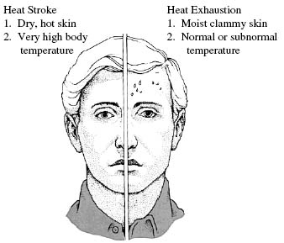

Slide 15
Heat Stroke Care
Immediately call 911
If possible, move to a cooler environment
Begin rapid cooling methods
Douse the employee with ice water-soaked towels over the entire body, spray with cold water, fan or cover the patient with ice towels
Take steps to minimize shock
Be prepared to give ventilations or perform CPR, if needed

Slide 16
SYMPTOMS
HEAT EXHAUSTION
Skin is pale
Excessive sweating
May faint but usually conscious
Headache
Nausea and vomiting
Blurred vision
Dizziness
HEAT STROKE
Skin is red and hot
No sweating
Unconscious or incoherent

Slide 17
TREATMENT
HEAT EXHAUSTION
Call Supervisor
Rest in cool place
Loosen and remove unnecessary clothing
Shower or sponge with cool water
HEAT STROKE
Call 911
Immediate, aggressive, effective cooling
DO NOT give anything by mouth

Slide 18
ENVIRONMENTAL RISK FACTORS
Air temperature
Direct sunlight
Radiant heat
Humidity
Little air movement

Slide 19
JOB RISK FACTORS
Work intensity
Work duration
Location (roof, road, enclosure)
Clothing (weight, impermeability)
Respiratory protection
Working inside closed buildings

Slide 20
WORKER RESPONSIBILITY
Be watchful for symptoms (self and others)
Properly hydrate (before, during, after)
Provide fans and open windows when possible
Job rotation / frequent breaks
Report any illness to your supervisor immediately
Get adequate rest
Avoid alcohol, unnecessary medication, and caffeine

